Slide 2
DISASTER MANAGEMENT
Art Pertile, III
PARTNER

Slide 3
Disaster Management
Disaster Declaration
Mayor.
7 days.
Disaster Extension – Council Approval.
Quorum not necessary if disaster prevents City from reaching one.

Slide 4
Disaster Management
Letter To Governor Requesting Declaration

Slide 5
Disaster Management
Call Texas Emergency Operations Center if seeking State or Federal assistance and to find out who is the Disaster District Chairperson (DDC) for your area. 512-424-2208

Slide 6
Disaster Management
Hazard Mitigation Grant Program
Full Federal Disaster Declared.
25/75 match grant program.
Must have an approved Hazard Mitigation Plan.
Fund projects that reduce or eliminate need to respond.
Warning systems, generators, community tornado safe rooms, flood prone area home buy out, radios, etc.

Slide 7
Disaster Management
CHECK LIST:
Activate your emergency operations center (EOC)
Disaster Declaration
Letter to Governor
Notification of DDC
Prepare Disaster Summary Outline (DSO)

Slide 8
Disaster Management
CHECK LIST
Departments meet to prepare DSO information
Prepare DSO Form
Send Disaster Declaration, Letter to Governor and completed DSO to Texas Department of Emergency Management

Slide 9
Disaster Management
MUTUAL AID AGREEMENTS

Slide 10
Disaster Management

Slide 11
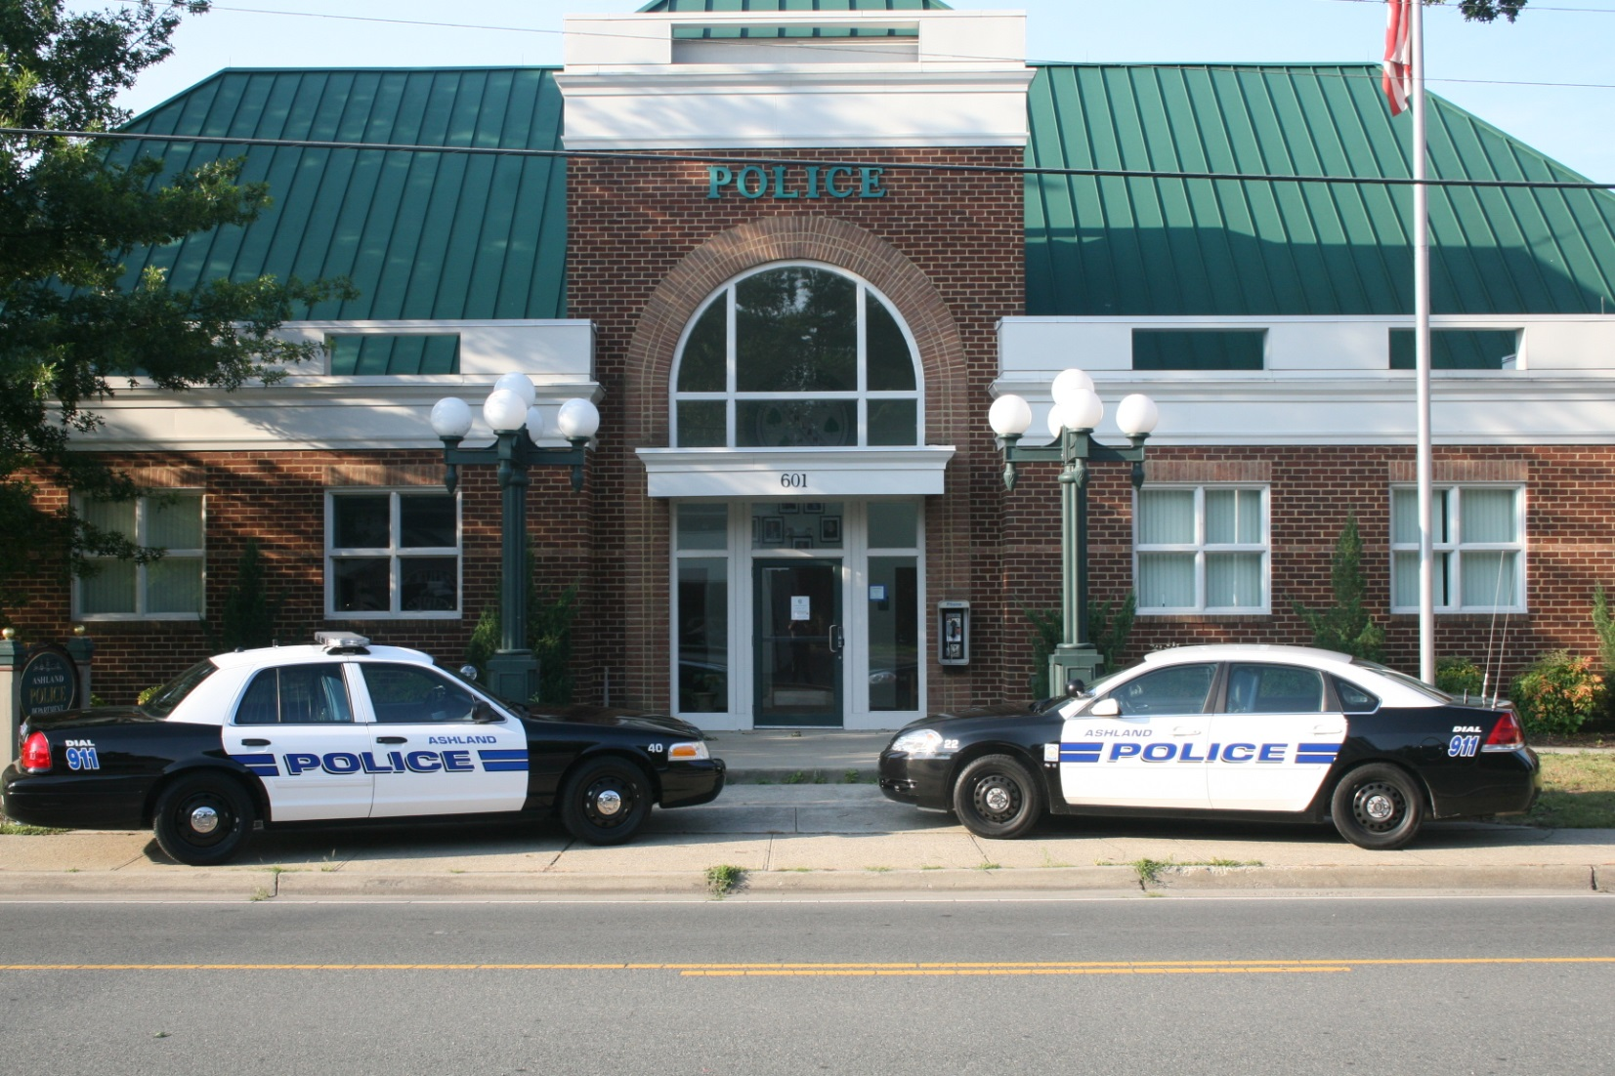
Disaster Management

Slide 12
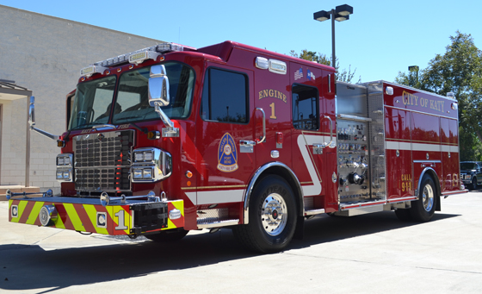
Disaster Management

Slide 13
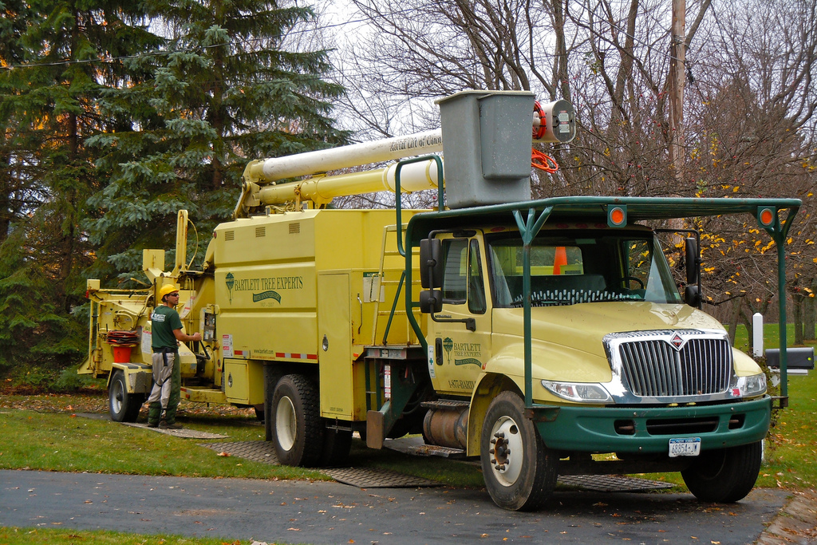
Disaster Management

Slide 14
Disaster Management

Slide 15
Disaster Management
Facility Agreements

Slide 16
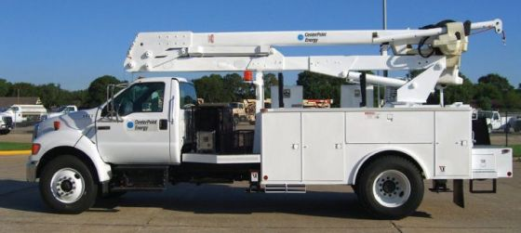
Disaster Management

Slide 17
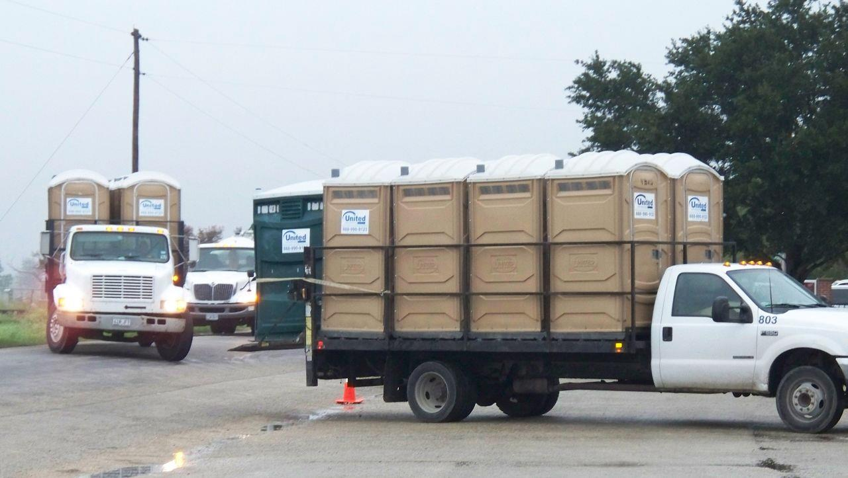
Disaster Management

Slide 18
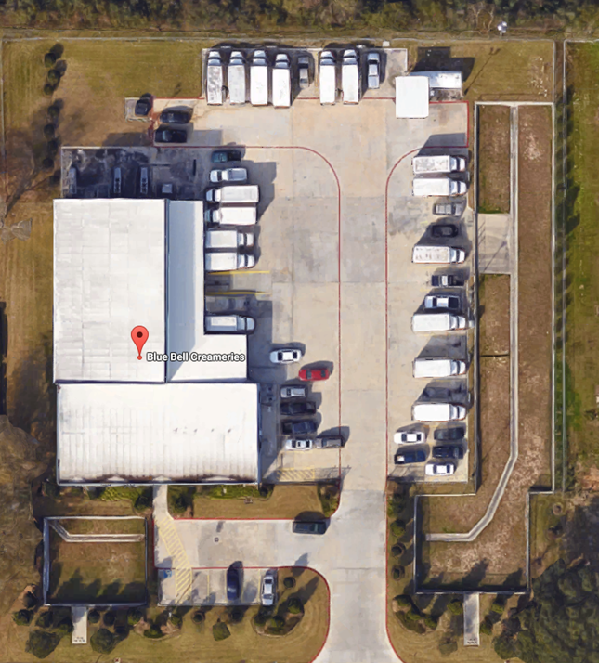
Disaster Management

Slide 19
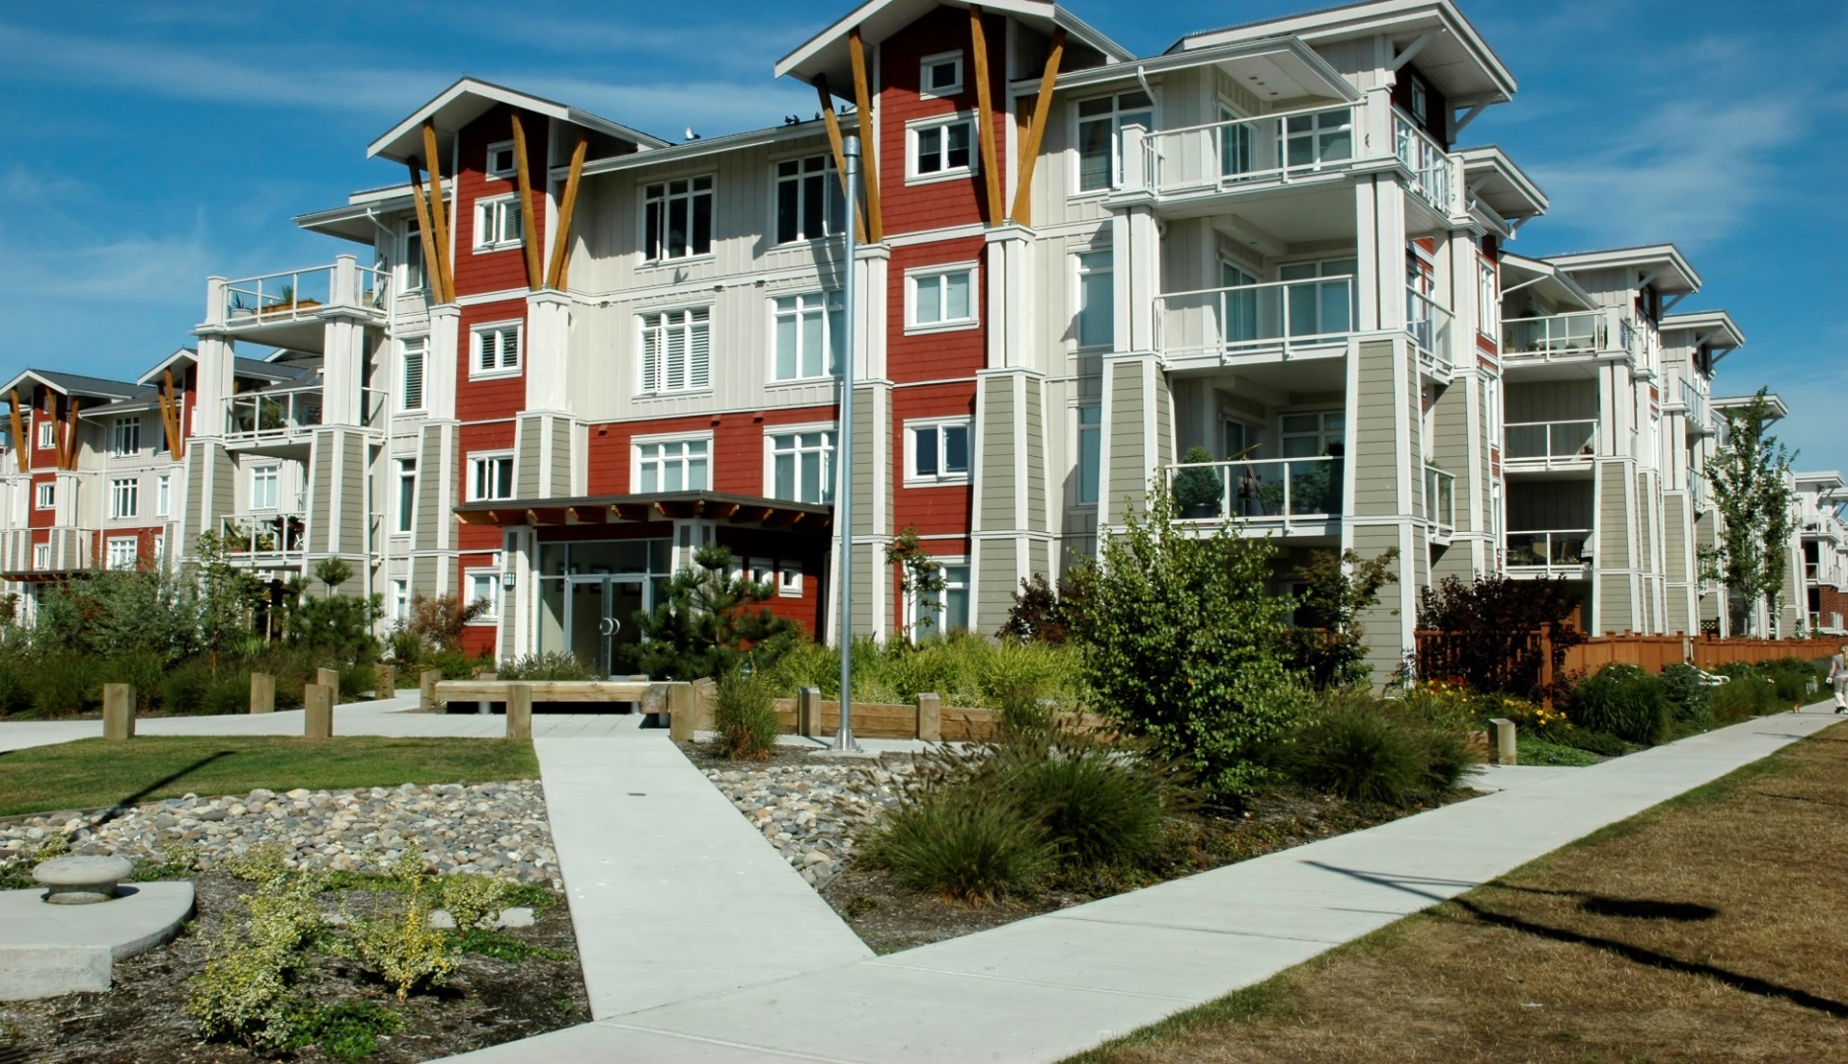
Disaster Management

Slide 20
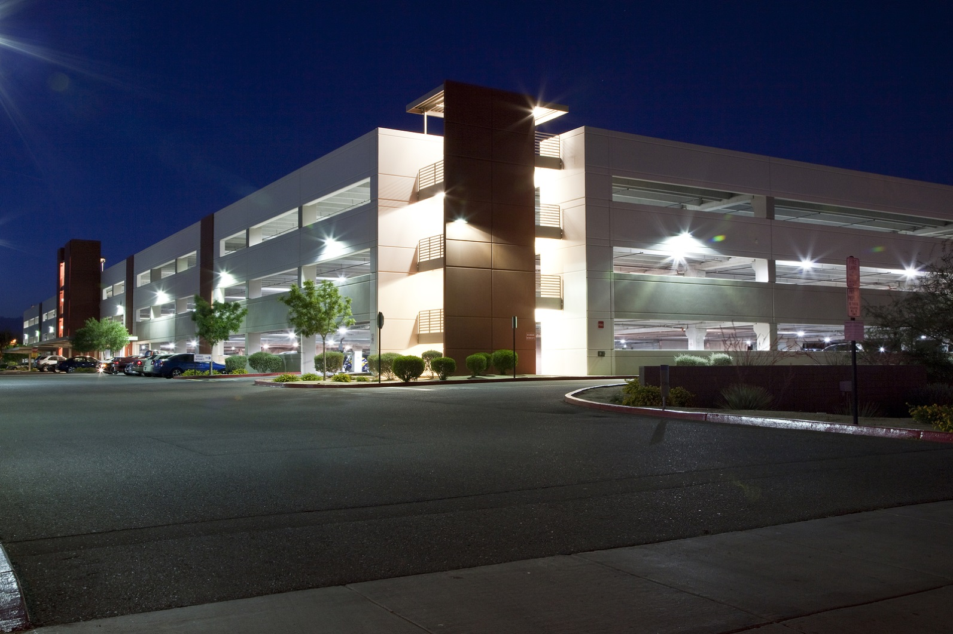
Disaster Management

Slide 21
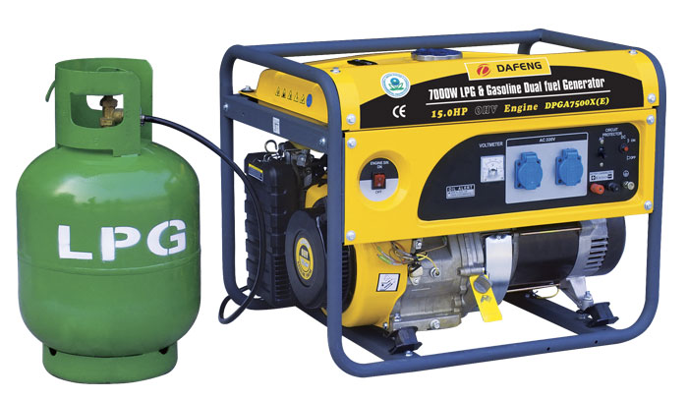
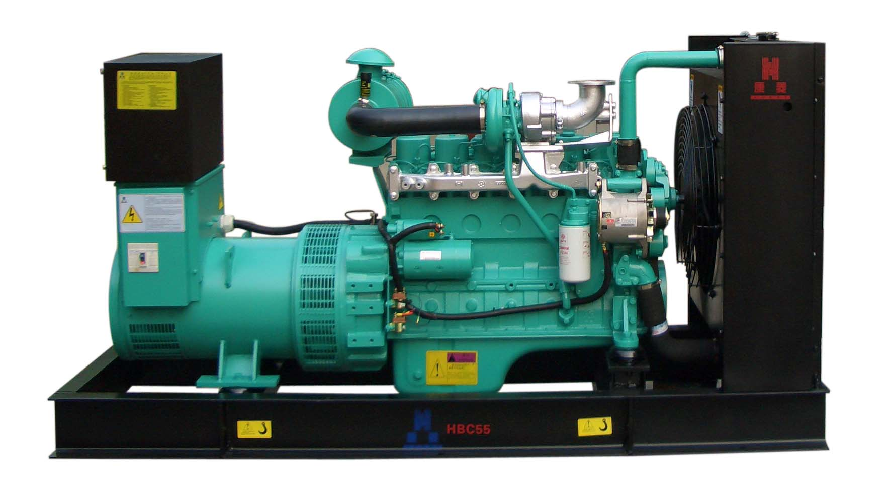
Disaster Management

Slide 22
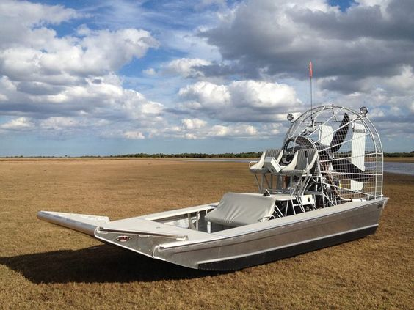
Disaster Management

Slide 23
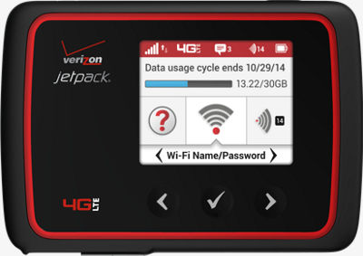
Disaster Management

Slide 24
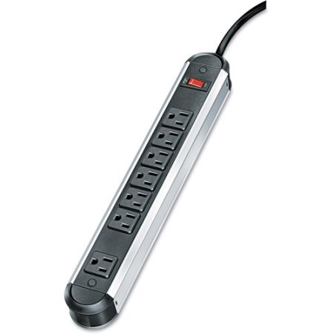
Disaster Management

Slide 25
Disaster Management
ORDINANCES

Slide 26
Disaster Management
ANNEX “U”
Declaration;
Extension;
Suspend and modify existing ordinances;

Slide 27
Disaster Management
ANNEX “U”
Evacuate persons from the entity or parts of the entity;
Establish curfews;
Restrict or deny access to a certain area;

Slide 28
Disaster Management
ANNEX “U”
Control the movement of persons and occupancy of premises in a disaster area;
Implement wage, price, and rent controls;

Slide 29
Disaster Management
ANNEX “U”
Establish rationing for critical supplies;
Limit or restrict use of water or other utilities;
Restrict the sale or use of gasoline or other flammable or combustibles;

Slide 30
Disaster Management
ANNEX “U”
Prohibit the sale of explosives; and
Prohibit the sale of alcohol.

Slide 31
DISASTER MANAGEMENT
Art Pertile, III
PARTNER
Download Presentation Exhibits at: olsonllp.org/pdf/apertile.pdf

